Slide 1
Systems Software
Assembler

Slide 2
ASSEMBLER
Introduction, Cross Assembler, Micro Assembler, Meta Assembler, Single pass Assembler, Two Pass Assembler, Design of Operation code table, Symbol table, Literal table.
MACRO PROCESSOR
Introduction of Macros, Macro processor design, Forward reference, Backward reference, positional parameters, keyword parameters, conditional assembly, Macro calls within Macros, Implementation of macros within Assembler.
Designing Macro name table, Macro Definition table, Kew word
parameter table, Actual parameter table, Expansion time variable storage.

Slide 3
RUN TIME ENVIRONMENT
Absolute loader, Relocation - Relocating loader, Dynamic loader, Bootstrap loader, Linking-loader, Program relocatibility, Design of Absolute Loader, Design of direct-linking editor, other Loader scheme e.g. (Binders, Linking Loaders, Overlays, Dynamic Binders).
Books
1). A.V.Aho, R.Sethi & J D.Ullman, “Compilers-Principles, Techniques and Tools”. Pearson, 2006 2). Leland L. Beck ,” System Software -An Introduction to System Programming”, 3/E, Addision Wesley,reprint 2003 3). Louden , Kenneth C :” Compiler Construction-Principles and Practice”,1/E, Thomson, 1997 4). D. M. Dhamdhere : “ System Programming and Operating System”.,2/E,TMH,1999 5). Houlb : Compiler Design in C, PHI, EEE, 1995

Slide 4
Assembler Definition
An assembly language is a low-level programming language for microprocessors and other programmable devices.
Each assembly language is specific to a particular computer architecture.
Assembly language is machine dependent, low-level programming language which is specified to a certain computer system(or a family of computer system).
Assembly language is converted into executable machine code by a utility program(according to computer infrastructure) referred to as an assembler.

Slide 5
Cross Assembler
A cross assembler is a program which generates machine code for a processor other than the one it is currently run on.
An assembler is a program that converts assembly language into the actual binary processor specific machine code.
Normally the machine code generated is for the processor used in the machine it is run on. A cross assembler takes this conversion process a step further by allowing you to generate machine code for a different processor than the one the compiler is run on.

Slide 6
Cross Assembler
Cross-assembling facilitates the development of programs for systems that do not have the resources to support software development, such as an embedded system. In such a case, the resulting object code must be transferred to the target system, either via read-only memory (ROM, EPROM, etc.)

Slide 7
Microassembler
A microassembler is a computer program that helps prepare a microprogram, called firmware(permanent software programmed into a read-only memory.), to control the low level operation of a computer in much the same way an assembler helps prepare higher level code for a processor.
The difference is that the microprogram is usually only developed by the processor manufacturer and works intimately with the computer hardware.
The use of a microprogram allows the manufacturer to fix certain mistakes, including working around hardware design errors, without modifying the hardware.

Slide 8
Meta Assembler
meta-assembler A program that accepts the syntactic and semantic description of an assembly language, and generates an assembler for that language.

Slide 9
Basic three features for simplify programming
Mnemonic operation codes(mnemonic opcodes ):
Assembly language uses a mnemonic to represent each low-level machine instruction or operation
Eliminates to memorize numerical opcodes.
Provides helpful diagnostics.

Slide 10
Symbolic operands
Symbolic names can be associated with data or instructions
It can also be used as operands in assembly language.
Specify the data required by the operation
Executable instructions can have zero to three operands
Operands can be registers, memory variables, or constants

Slide 11
Data Declaration
Data can be declared in verity of notations
Avoids manual conversation of constants into their internal machine representation.

Slide 12
Statement Format
Assembly language statement format
[label] <Opcode> <Operand spec>[, <Operand spec>..]
Anything Between this [..] is optional field.
When label is their then it contains symbolic name

Slide 13
<Operand spec> has following syntax:
<symbolic name> [+<displacement>][(index register)]
examples

Slide 14
Statement Format:
[Label] <Opcode> <operand spec> [,<operand spec>…]
<operand spec> format:
<Symbolic name> [+<displacement>][(<index register>)]
Ex. AREA+5(4)
Example’s specification is a combination of previous two.
Memory word with which
name AREA is associated
Displacement /offset from AREA
Operand address is obtained by adding the contents of index register 4 to the address of AREA

Slide 15
Instruction opcode | Assembly mnemonic
00 | STOP | Stop execution
01 | ADD
02 | SUB | First operand is modified
03 | MULT
04 | MOVER | Register memory move
05 | MOVEM | memory Register move
06 | COMP
07 | BC | Branch on condition
08 | DIV | Analog to SUB
09 | READ | First operand is
10 | PRINT | not used

Slide 16
Simple assembly languages
In Assembly language each statement has 2 operands
First operand is always a register
Second is memory word using a symbolic name & optional displacement
MOVER: Second operand is source& first is target
MOVEM: opposite to MOVER
All arithmetic is performed in a registe.
Condition code can be tasted by a Branch on Condition (BC) instruction.
BC <condition code spec>, <memory address>
Transfers control to the memory word with memory address> if current value of condition code matches <condition code spec>.

Slide 17
Conditional Code
It can be tested by Branch on condition (BC) instruction.
Format:
BC <conditional code spec> ,<memory address>
Conditional codes are LE,EQ,GE,LT,GT,ANY

Slide 18
Machine instruction format
Machine instruction format
In this format all the addresses and constants are shown in decimal rather than octal or hexadecimal.
Sign opcode Reg Memory
operand operand

Slide 19
 | START | 101
 | READ | N | 101) | + 09 0 113
 | MOVER | BREG,ONE | 102) | + 04 2 115
 | MOVEM | BREG, TERM | 103) | + 05 2 116
AGAIN | MULT | BREG, TERM | 104) | + 03 2 116
 | MOVER | CREG, TERM | 105) | + 04 3 116
 | ADD | CREG, ONE | 106) | + 01 3 115
 | MOVEM | CREG, TERM | 107) | + 05 3 116
 | COMP | CREG, N | 108) | + 06 3 113
 | BC | LE, AGAIN | 109) | + 07 2 104
 | MOVEM | BREG, RESULT | 110) | + 05 2 114
 | PRINT | RESULT | 111) | + 10 0 114
 | STOP |  | 112) | + 00 0 000
N | DS | 1 | 113)
RESULT | DS | 1 | 114)
ONE | DC | ‘1’ | 115)
TERM | DS | 1 | 116) | + 00 0 001
 | END
Assembly and equivalent machine language

Slide 20
Assembly language statements
Assembly program contains three kinds of statements
Imperative statements
Declaration Statements
Assembler Directives

Slide 21
Imperative statements:
Actions to be performed during the execution of assembled program.
Imperative statements represent machine instructions in symbolic form.
For example, add means an addition instruction and mov denotes a data transfer instruction.

Slide 22
Declaration Statements:
Syntax of declaration statement
[Label] DS <constant>
[Label] DC ‘<Value>’
DS (declare storage) :
Reserves area of memory and associated name with them

Slide 23
Statements are
X DS 1
Z DS 100
First statement reserves 1 word with the name X.
Second statement ?

Slide 24
DC (Declare Constant)
It constructs memory words containing constans
XYZ DC ‘1’
It assigns memory word containing the value ‘1’ to XYZ

Slide 25
Constants
DC doesn’t implement constants its only initialize block with the value.
This value can be changed
MOVEM CREG , XYZ
Constants can be implemented in two ways
Immediate operands
Literals

Slide 26
For ex
ADD AREG , 5
Note: simple assembly language doesn’t support this ,but intel 8086 supports it.
Literal
It is operand with =‘<value>’ syntax
Its differ from constant because its location cannot be specified in assembly program.
Its value cannot be changed during the execution of program

Slide 27
ADD BREG , =’50’
Assembler Directives
It instruct the assembler to perform certain action during program
START <constants>
Starts the target program with particular address
END
end of source program

Slide 28
Advantages of assembly language:
Use of symbolic operand specifications:
insertion of one statement in assembly program leads to changes in address of constants and reserved memory areas.
So addresses used in most instructions of the program had to change.
Such changes are not needed in assembly program.

Slide 29
 | START | 101
 | READ | N | 101) | + 09 0 113
 | MOVER | BREG,ONE | 102) | + 04 2 115
 | MOVEM | BREG, TERM | 103) | + 05 2 116
AGAIN | MULT | BREG, TERM | 104) | + 03 2 116
 | MOVER | CREG, TERM | 105) | + 04 3 116
 | ADD | CREG, ONE | 106) | + 01 3 115
 | MOVEM | CREG, TERM | 107) | + 05 3 116
 | COMP | CREG, N | 108) | + 06 3 113
 | BC | LE, AGAIN | 109) | + 07 2 104
 | DIV | BREG, TWO | 110) | + 08 2 118
 | MOVEM | BREG, RESULT | 111) | + 05 2 114
 | PRINT | RESULT | 112) | + 10 0 114
 | STOP |  | 113) | + 00 0 000
N | DS | 1 | 114)
RESULT | DS | 1 | 115)
ONE | DC | ‘1’ | 116)
TERM | DS | 1 | 117) | + 00 0 001
TWO | DC | ‘2’ | 118) | + 00 0 001
 | END

Slide 30
Assembly language programming holds an edge over HLL in situation where it is necessary or desirable to use specific architectural features of computer.
Ex. Special instructions supported by CPU

Slide 31
Design Specifications of an assembler:
Identify the information necessary to perform a task
Design a suitable data structure to record the information
Determine the processing necessary to obtain and maintain the information
Determine the processing necessary to perform a task
The fundamental info requirements arise in the synthesis phase.

Slide 32
Synthesis Phase
Consider the assembly statement
MOVER BREG, ONE
We must have the following information to synthesize the machine instruction
Address of the memory word with which ONE is associated
It depends on source program
So, it must be made available by analysis phase.
Machine operation code corresponding to the mnemonic MOVER
Does not depend on source program, but depend upon assembly language
Hence the synthesis phase can determine this information Itself.

Slide 33
During synthesis phase, two data structures are used:-
Symbol Table
symbol table’s each entry has two fields:-
name and address.
This table is built by analysis phase and used during synthesis.
Mnemonics Table
An entry in the mnemonics table has two fields:-
mnemonic and opcode.
fixed table and merely accessed by analysis and synthesis phases.
By using symbol table, synthesis phase obtains the machine address with which name is associated.
By using Mnemonics table, synthesis phase obtains machine opcode corresponding to a mnemonic.

Slide 34
Analysis phase
The primary function performed by the analysis phase is the building of the symbol table.
For this, it must determine the addresses with which symbolic names used in a program are associated.
Some addresses can be determined directly (Eg. Address of first instruction in program) while some other must be inferred. (Eg. In prog. for determining address of N, we must fix address of all program elements preceding it.) This is called memory allocation.

Slide 35
Location Counter
Location Counter (LC) is a data structure which use to implement memory allocation
The location counter contains the address of the next memory word in the target program.
LC is initialized to the constant specified in the START statement.
To update the contents of LC, analysis phase needs to know the lengths of different instructions.
This info. Depends on the assembly language.
To include this Mnemonic table can be extended and a new field called as length is used
The processing involved to maintain the LC is called LC processing.

Slide 36
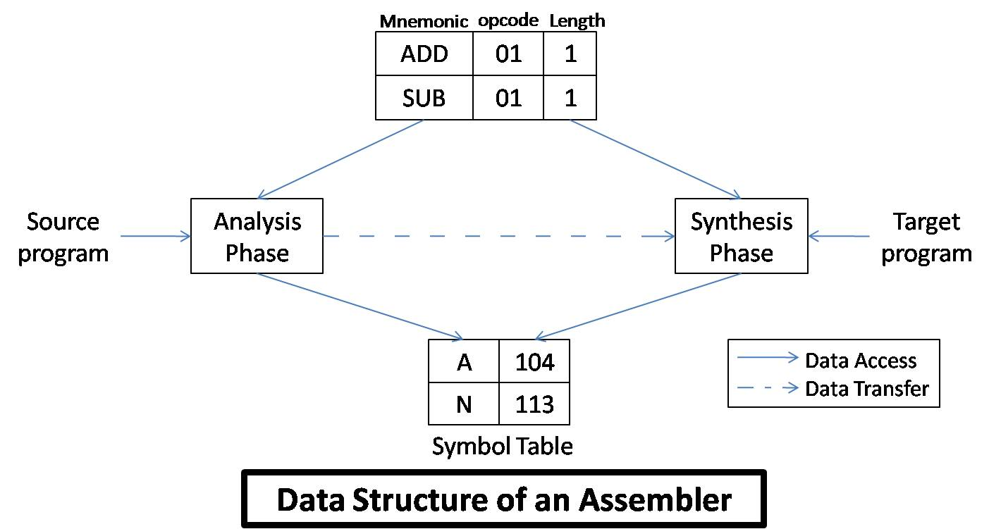

Slide 37
Tasks performed by Analysis Phases:-
Isolate the label, mnemonic opcode and operand fields of a statement.
If a label is present, enter the pair (symbol,<LC contents>) in a new entry of symbol table.
Check validity of mnemonic opcode by look-up in Mnemonics table.
Perform LC processing i.e. update value contained in LC.

Slide 38
Tasks performed by Synthesis Phase:-
Obtain the machine opcode corresponding to mnemonics from mnemonics table.
Obtain address of memory operand from symbol table.
Synthesize the machine form of a constant, if any.

Slide 39
Pass Structure of Assemblers
The pass of a language processor is one complete scan of the source program.
There are mainly two assembly schemes:-
Two pass assembly scheme
One pass assembly scheme.

Slide 40
Two Pass Translator / Two Pass Assembler
can handle forward references easily.
The LC processing is performed in the first pass and symbols defined in the program are entered into the symbol table in this pass.
The first pass performs analysis of the source program while the second pass performs the synthesis of the target program.
The first pass constructs an intermediate representation (IR) of the source program for use by the second pass.
This representation consists of two main components
data structures e.g. Symbol table
a processed form of source program. Also called as Intermediate Code (IC).

Slide 41
Single Pass Translation / Single Pass Assembler
In a single pass assembler, the LC processing and construction of symbol table proceeds as in two pass assembler.
The problem of forward references is tackled using a process called back patching.
Initially, operand field of an instruction containing a forward reference is left blank.
When the definition of forward referenced symbol in encountered, its address is put into this field which is left blank initially.

Slide 42
ONE is a forward reference.
The instruction opcode and address of BREG will be assembled to reside in location 101 and the insertion of second operand’s address at a later stage can be indicated by adding an entry of the Table of Incomplete Instructions.(TII)
This entry is a pair ([instruction address], [symbol]).
e.g. (101, ONE) in this case.
By the time, the END statement is processed, the symbol table would contain the addresses of all symbols defined in the source program and TII would contain info. describing forward references.

Slide 43
Design of a Two Pass Assembler

Slide 44
PASS 1:-
Separate the symbol, mnemonic opcode and operand fields.
Build the symbol table.
Perform LC processing.
Construct intermediate representation
PASS 2:-
The Pass 1 performs analysis of the source program and synthesis of the intermediate representation
while Pass 2 processes the intermediate representation (IR) to synthesize the target program.

Slide 45
Advanced Assembler Directives
(i) ORIGIN:-
The syntax of this directive is ORIGIN [address spec]
where [address spec] is an [operand spec] or [constant].
This directive indicates that LC should be set to the address given by [address spec].
The ‘ORIGIN’ statement is useful when the target program does not consist of consecutive memory words. The ability to use an [address spec] in the ORIGIN statement provides the ability to perform LC processing in a relative manner rather than absolute manner.

Slide 46
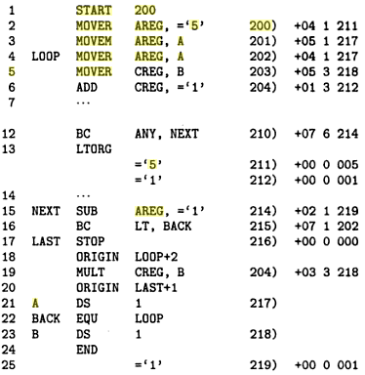

Slide 47
(ii) EQU:-
The syntax of this directive is
[symbol] EQU [address spec] where [address spec] is an [operand spec] or [constant].
The EQU statement defines the symbol to represent [address spec].
BACK EQU LOOP

Slide 48
LTORG:-
The LTORG statement permits a programmer to specify where literals should be placed.
By default, assembler places the literals after the END statement.
At every LTORG statement, the assembler allocates memory to the literals of a literal pool.
This pool contains all the literals used in the program.

Slide 49
Pass 1 of the Assembler
Pass 1 uses the following data structures:
OPTAB: - A table of mnemonic opcodes and related info.
SYMTAB: - Symbol Table. (contains the fields address and length)
LITTAB: - A table of literals used in the program.(contains the fields literal and address.)

Slide 50
OPTAB: Static table: The content will never change
contains the fields mnemonic opcode, class and mnemonic information.
The ‘class’ field indicates whether the opcode corresponds to
an imperative statement (IS),
a declaration statement (DL) or
an assembler directive (AD)
If an imperative statement is present,
then the mnemonic info. field contains the pair (machine opcode, instruction length)
else it contains the pair id of a routine to handle the declaration or directive statement.

Slide 51
In pass 1, OPTAB is used to look up and validate mnemonics in the source program.
In pass 2, OPTAB is used to translate mnemonics to machine instructions.
SYMTAB
Include the label name and value (address) for each label in the source program
Dynamic table (I.e., symbols may be inserted, deleted, or searched in the table)

Slide 52
The LITTAB is used to collect all literals used in the program. The awareness of different literals pools in maintained by an auxiliary table POOLTAB. This table contains the literal no. of starting literal of each literal pool.

Slide 53
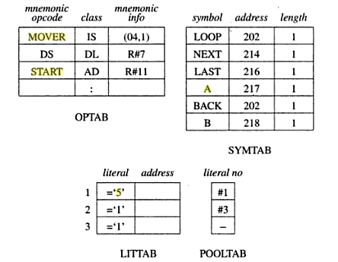
Data Structure of Assembler pass 1

Slide 54
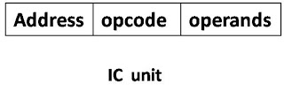
Intermediate Code forms
The intermediate code consists of a set of IC units, each IC unit consisting of following three fields: -
Address
Representation of mnemonic op code
Representation of operands

Slide 55
There are generally two criteria for choice of intermediate code (IC)
processing efficiency
memory economy.
Arise of some variants forms of intermediate code mainly operand and address fields is due to trade off between processing efficiency and memory economy.

Slide 56
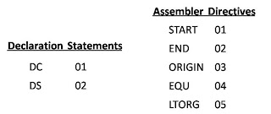
The mnemonic field contains a pair of the form
(statement class, code)
Here, statement class can be one of the imperative (IS) (DL) (AD).
For (IS), code is the instruction opcode in machine language.
For DL and AD, code in an ordinal number within class.

Slide 57
Intermediate Code for Imperative Statement

Slide 58
Variant I:
The first operand is represented by a single digit number which is a code for register (i.e. 1-4 for AREG – DREG) or condition code itself (1-6 for LT-ANY)
The second operand, which is memory operand, is represented by a pair of form (operand class, code)
where operand class is one of C, S and L standing for constant, symbol and literal resp.
For a constant, code field contains internal representation of constant itself.
For symbol or literal, code field contains the ordinal no. of operand’s entry in SYMTAB or LITTAB.

Slide 59
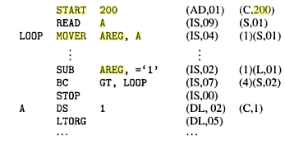
Intermediate Code- Variant I

Slide 60
Variant II:
This variant differs from variant 1 in that the operand fields of source statements are replaced by their processed forms.
For declarative statements and assembler directives, processing of operand fields contain processed forms.
For imperative statements, the operand field is processed only to identify literal references.

Slide 61
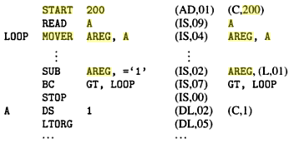
Variant 2 reduces the work of Pass 1 by transferring burden of operand processing from Pass 1 to pass 2.

Slide 62
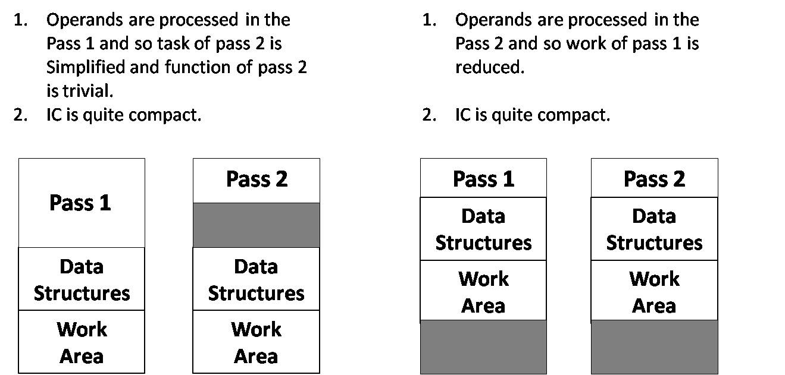

Slide 63
 | START MOVER | 123 BREG,ONE
 | MULT | BREG, TERM
 | MOVEM | BREG, ANS
 | PRINT STOP | ANS
ONE | DC | ‘2’
TERM | DC | ‘5’
ANS | DS | 1
 | END
STOP 00
MULT 03
MOVER 04
MOVEM 05
PRINT 10
START 01
END 02

Slide 64
AGAIN N NOW RESULT TERM | START 101 READ N MOVER BREG, ‘=1’ MOVEM BREG, TERM MULT BREG, TERM MOVER CREG, TERM ADD CREG, ‘=1’ MOVEM CREG, TERM LTORG ‘=1’ COMP CREG, N BC LE, NOW MOVEM BREG, RESULT PRINT RESULT STOP DS 1 EQU AGAIN DC ‘1’ DS 1 END | Mnemonics CODE STOP 00 ADD 01 MULT 03 MOVER 04 MOVEM 05 COMP 06 BC 07 READ 09 PRINT 10 LE 02 START 01 END 02 BREG 2 CREG 3 EQU 04

Slide 65
MACROS AND MACRO PROCESSORS
INTRODUCTION
→Macro allows programmer to write short hand programs (modular programming).
→The macro processor replaces each macro instruction with its equivalent block of instructions.

Slide 66
Macro Processor
Recognize macro definitions
Save the macro definition
Recognize macro calls
Expand macro calls
Source Code
(with macro)
Macro Processor
Expanded Code
Compiler or Assembler
obj

Slide 67
MACROS :
→A Macro is an extension to the basic ASSEMBLER language.
→They provide a means for generating a commonly used sequence of assembler instructions/statements.
→The sequence of instructions/statements will be coded ONE time within the macro definition. Whenever the sequence is needed within a program, the macro will be "called".

Slide 68
→Macros are used to provide a program generation facility through macro expansion.
→The program generator is a software system which accepts the specification of a program to be generated, and generates a program in the target PL.
Program
Specification Program in
target PL
Program generator

Slide 69
→Many languages provide built in facilities for writing macros. →Well known examples are the higher level languages PL/I, C, Ada and C++. →Assembly languages of most computer systems also provide such facilities. →When a language does not support built in macros facilities, a programmer may achieve an equivalent effect by using generalized preprocessors or software tools like Awk of Unix.

Slide 70
Standard Definitation: →A macro is a unit of specification for program generation through expansion. →A macro consists of a name, a set of formal parameters and a body of code. →The use of macro name with a set of actual parameters is replaced by some code generated by its body. This is called Macro Expansion. There are two kinds of expansions: 1) Lexical expansion 2) Semantic expansion

Slide 71
1) Lexical expansion: lexical expansion implies replacement of a character string by another character string during program execution. →It is typically employed to replace occurrences of formal parameters by corresponding actual parameters. 2) Semantic expansion: semantic expansion implies generation of instructions tailored to the requirements of a specific usage—for eg : generation of type specific instructions for manipulation of byte and word operands. →It is characterized by the fact that different uses of a macro can lead to codes which differ in the number, sequence and opcodes of instructions.

Slide 72
Example: →The following sequence of instructions is used to increment the value in a memory word by a constant : 1) Move the value from the memory word into the machine register. 2) Increment the value into the machine register. 3) Move the new value into the memory word. →Since the instruction sequence MOVE-ADD-MOVE may be used a number times in a program, it is convenient to define a macro named INCR.

Slide 73
→ Using lexical expansion the macro call INCR A, B, AREG can lead to the generation of a MOVE-ADD-MOVE instruction sequence to increment A by the value of B using AREG to perform the arithmetic. → Use of semantic expansion can enable the instruction sequence to be adapted to the types of A and B. for eg: for Intel 8088, an INC instruction could be generated if A is a byte operand and B has the value ‘1’, while a MOVE-ADD-MOVE sequence can be generated in all other situations.

Slide 74
Macro vs. Subroutine → The macros differ from subroutines in one fundamental respect. → Use of a macro name in the mnemonic field of an assembly statement leads to its expansion. → In other words, the statement of expansion are generated each time the macro are invoked → Whereas use of a subroutine name in a call instruction leads to its execution. → Thus programs using macros and subroutines differ significantly in terms of program size and execution efficiency.

Slide 75
MACRO DEFINITION AND CALL Macro definition: A macro definition is enclosed between a macro header statement and a macro end statement. → Macro definitions are typically located at the start of the program. → A macro definition consists of : 1) A macro prototype statement. 2) One or more model statements. 3) Macro preprocessor statements.

Slide 76
→The macro prototype statement declares the name of a macro and the names and kinds of its parameters. →A model statement is a statement from which an assembly language statement may be generated during macro expansion. →A preprocessor statement is used to perform auxiliary functions during macro expansion. →The macro prototype statement has the following syntax : <macro name> [ <formal parameter spec> [,..] ] where <macro name> appears in the mnemonic field of an assembly statement and <formal parameter spec> is of the form &<parameter name> [ <parameter kind> ]

Slide 77
Macro call → A macro is called by writing the macro name in the mnemonic field of an assembly statement. → The macro call has the syntax : <macro name> [ <actual parameter spec> [,..] ] where an actual parameter typically resembles an operand specification in an assembly language statement.

Slide 78
Example showing the definition of macro INCR MACRO INCR &MEM_VAL, &INCR-VAL, &REG MOVER &REG, &MEM_VAL ADD &REG, &INCR_VAL MOVEM &REG, &MEM_VAL MEND →MACRO and MEND are the macro header & macro end statements.

Slide 79
Macro expansion → A macro call leads to macro expansion. → During macro expansion, the macro call statement is replaced by a sequence of assembly statements. →To differentiate between the original statements of a program and the statements resulting from macro expansion, each expanded statement is marked with a ‘+’ preceding its label field.

Slide 80
Two key notions concerning macro expansion are: 1) Expansion time control flow: This determines the order in which model statements are visited during macro expansion. 2) Lexical substitution: Lexical substitution is used to generate an assembly statement from a model statement.

Slide 81
Flow of control during expansion → The default flow of control during macro expansion is sequential. → Thus in the absence of preprocessor statements, the model statements of a macro are visited sequentially starting with the statements following the macro prototype statements and ending with the statements preceding the MEND statements. → A preprocessor statements can alter the flow of control during expansion.

Slide 82
→ Alters in such a way that model statements are either never visited during expansion, or are repeatedly visited during expansion. → The flow of control during macro expansion is implementated using a macro expansion counter (MEC).

Slide 83
Algorithm of macro expansion 1) MEC:=statement no of first statement following the prototype statement; 2) While statement pointed by MEC is not a MEND statement (a) if a model statement then (i) expand the statement (ii) MEC:=MEC+1; (b) else(i.e. a preprocessor statement) (i) MEC:=new value specified in the statement 3) Exit from macro expansion

Slide 84
Lexical substitution A model statement consists of 3 types of strings: 1) An ordinary string, which stands for itself. 2) The name of a formal parameter which is preceded by the character ‘&’. 3) The name of a preprocessor variable, which is also preceded by the character ‘&’.

Slide 85
Positional parameters → A positional formal parameter is written as &<parameter name> e.g. &SAMPLE where SAMPLE is the name of parameter → In other words, <parameter kind> is omitted. → The <actual parameter spec> in a call on a macro using positional parameters is simply an <ordinary string>. → The value of a positional formal parameter XYZ is determined by the rule of positional association as follows :

Slide 86
1) Find the ordinal position of XYZ in the list of formal parameters in the macro prototype statement. 2) Find the actual parameter specification occupying the same ordinal position in the list of actual parameters in the macro call statement. Consider the call : INCR A, B, AREG on macro INCR

Slide 87
Following the rule of positional association, values of the formal parameters are: formal parameters value MEM_VAL A INCR_VAL B REG AREG Lexical expansion of the model statements now leads to the code as follows : + MOVER AREG, A + ADD AREG, B + MOVEM AREG, A

Slide 88
Keyword parameters → For keyword parameters, <parameter name> is an ordinary string and <parameter kind> is the string “=“. → The <actual parameter spec> is written as <formal parameter name> = <ordinary string> → The value of a formal parameter XYZ is determined by the rule of keyword association as follows :

Slide 89
1) Find the actual parameter specification which has the form XYZ = <ordinary string>. 2) Let <ordinary string> in the specification be the string ABC. Then the value of formal parameter XYZ is ABC. → For eg : the macro INCR can be rewritten as macro INCR_M using keyword parameters. → The following macro calls are now equivalent INCR_M MEM_VAL=A, INCR_VAL=B, REG=AREG ….. INCR_M INCR_VAL=B, REG=AREG, MEM_VAL=A

Slide 90
A macro definition using keyword parameters MACRO INCR_M &MEM_VAL=, &INCR_VAL=, &REG= MOVER &REG, &MEM_VAL ADD &REG, &INCR_VAL MOVEM &REG, &MEM_VAL MEND

Slide 91
Default specifications of parameters → It is useful in situations where a parameter has the same value in most calls. → When the desired value is different from the default value, the desired value can be specified explicitly in a macro call. → This specification overrides the default value of the parameter for the duration of the call. → Default specification of keyword parameters can be written as: &<parameter name> [ <parameter kind> [ <default value> ]]

Slide 92
Eg: A macro definition with default parameter → Register AREG is used for all arithmetic in a program. → Hence most calls on macro INCR_M contain the specification &REG=AREG. → The macro can be redefined to use a default specification for the parameter REG. → Consider the following calls: INCR_D MEM_VAL=A, INCR_VAL=B INCR_D INCR_VAL=B, MEM_VAL=A INCR_D INCR_VAL=B, MEM_VAL=A, REG=BREG

Slide 93
→ The first two calls are equivalent. → The third call overrides the default value for REG with the value BREG. → BREG will be used to perform the arithmetic in its expanded code. MACRO INCR_D &MEM_VAL=, &INCR_VAL=, &REG=AREG MOVER &REG, &MEM_VAL ADD &REG, &INCR_VAL MOVEM &REG, &MEM_VAL MEND

Slide 94
Macros with mixed parameters lists → A macro may be defined to use both positional and keyword parameters. → In such a case, all positional parameters must precede all keyword parameters. → For example, in the macro call : SUMUP A, B, G=20, H=X A, B are positional parameters while G, H are keyword parameters

Slide 95
Other uses of parameters → The model statements have used formal parameters only in operand fields. → However, use of parameters is not restricted to these fields. → Formal parameters can also appear in the label and opcode fields of model statements. → The example is shown below :

Slide 96
MACRO CALC &X, &Y, &OP=MULT, &LAB= &LAB MOVER AREG, &X &OP AREG, &Y MOVEM AREG, &X MEND Expansion of the call CALC A, B , LAB=LOOP leads to the following code: + LOOP MOVER AREG, A + MULT AREG, B + MOVEM AREG, A

Slide 97
Nested macro calls → A macro statement in a macro may constitute a call on another macro. Such calls are known as nested calls. → We refer to the macro containing the nested call as the outer macro and the called macro as the inner macro. → Thus in a structure of nested macro calls, expansion of the latest macro call (i.e. the innermost macro call in the structure) is completed first.

Slide 98
→ Macro COMPUTE contains a nested call on macro INCR_D COMPUTE X, Y → After the lexical expansion, the second model statement of COMPUTE is recognized to be a call on macro INCR_D. → Expansion of this macro is now performed. This leads to generation of statements marked 2, 3 and 4. → The third model statement of COMPUTE is now expanded. Thus the expanded code for the call on COMPUTE is :

Slide 99
A Nested macro call + MOVEM BREG, TMP + MOVER BREG, X + ADD BREG, Y + MOVEM BREG, X + MOVER BREG, TMP MACRO COMPUTE &FIRST, &SECOND MOVEM BREG, TMP INCR_D &FIRST, &SECOND, REG=BREG MOVER BREG, TMP MEND

Slide 100
Expanded code for a nested macro call + MOVEM BREG, TPM [1] + INCR_D X, Y +MOVER BREG, X [2] COMPUTE X, Y +ADD BREG, Y [3] +MOVEM BREG, X [4] + MOVER BREG, TMP[5]

Slide 101
Advanced macro facilities → These facilities can be grouped into : 1) Facilities for alteration of flow of control during expansion. 2) Expansion time variables. 3) Attributes of parameters. → These advanced facilities are used in performing conditional expansion of model statements and in writing expansion time loops.

Slide 102
Alteration of flow of control during expansion → Two features are provide to facilitate alteration of flow of control during expansion : 1) Expansion time sequencing symbols. 2) Expansion time statements AIF, AGO and ANOP. → A sequencing symbol (SS) has the syntax : .<ordinary string> → As SS is defined by putting it in the label field of a statement in the macro body. → It is used as an operand in an AIF or AGO statement to designate the destination of an expansion time control transfer.

Slide 103
→ An AIF statement has the syntax : AIF (<expression>) <sequencing symbol> where <expression> is a relational involving ordinary strings, formal parameters → If the relational expression evaluates to true, expansion time control is transferred to the statement containing <sequencing symbol> in its label field.

Slide 104
→ An AGO statement has the syntax : AGO <sequencing symbol> and unconditionally transfers expansion time control to the statement containing <sequencing symbol> in its label field. → An ANOP statement is written as : < sequencing symbol > ANOP and simply has the effect of defining the sequencing symbol.

Slide 105
MACRO EVAL &X, &Y, &Z AIF (&Y EQ &X) .ONLY MOVER AREG, &X SUB AREG, &Y ADD AREG, &Z AGO .OVER .ONLY MOVER AREG, &Z .OVER MEND

Slide 106
MACRO
EX1 &VAR1=AREG,&VAR2=,&VAR3=B
AIF (‘&VAR2’ EQ ‘ ’) .NOOPE
ADD &VAR1,&VAR3
.NOOPE ANOP
MULT &VAR1,&VAR3
MEND

Slide 107
Expansion time variables → Expansion time variables (EV’s) are variables which can only be used during the expansion of macro calls. → A local EV is created for use only during a particular macro call. → A global EV exists across all macro calls situated in a program. → Local and global EV’s are created through declaration statements with the following syntax :

Slide 108
LCL <EV specification> [, <EV specification> …] GBL <EV specification> [, <EV specification>…] and <EV specification has the syntax &<EV name>, where <EV name> is an ordinary string. → Value of EV’s can be manipulated through the preprocessor statement SET. → A SET statement is written as <EV specification> SET <SET-expression> where <EV specification appears in the label field and SET in the mnemonic field.

Slide 109
Each SET variable can be either local or global.
A local SET variable is assigned an initial value every time the macro is called.
It is known only to the macro it is created in.
A global SET variable is initialized the first time the macro is called and retains a value from one call to another.

Slide 110
→ A SET statement assigns the value of <SET-expression> to the EV specified in <EV specification>. → The value of an EV can be used in any field of a model statement, and in the expression of an AIF statement. MACRO CONSTANTS LCL &A &A SET 1 DC ‘&A’ &A SET &A+1 DC ‘&A’ MEND

Slide 111
Attributes of formal parameters → An attribute is written using the syntax : <attribute name>’<formal parameter spec> and represents information about the value of the formal parameter, i.e. the corresponding actual parameter. → The type, length and size attributes have the names T, L and S.

Slide 112
MACRO DCL_CONST &A AIF (L’&A EQ 1) .NEXT - - .NEXT - - - - MEND → Here expansion time control is transferred to the statement having .NEXT in its label field only if the actual parameter corresponding to the formal parameter A has the length of ‘1’.

Slide 113
Conditional Expansion → While writing a general purpose macro it is important to ensure execution efficiency of its generated code. → Conditional expansion helps in generating assembly code specifically suited to the parameters in a macro call. → This is achieved by ensuring that a model statement is visited only under specific conditions during the expansion of a macro. → The AIF and AGO statements are used for this purpose.

Slide 114
Consider the following call : EVAL A, B, C → It is required to develop a macro EVAL such that a call generates efficient code to evaluate A-B+C in AREG. → When the first two parameters of a call are identical, EVAL should generate a single MOVER instruction to load the 3rd parameter into AREG.

Slide 115
→ Since the values of a formal parameters is simply the corresponding actual parameter, the AIF statement effectively compares names of the first two actual parameters. → If the names are same, expansion time control is transferred to the model statement MOVER AREG, &Z. → If not, the MOVE-SUB-ADD sequence is generated and expansion time control is transferred to the statement .OVER MEND which terminates the expansion. → Thus efficient code is generated under all conditions.

Slide 116
MACRO EVAL &X, &Y, &Z AIF (&Y EQ &X) .ONLY MOVER AREG, &X SUB AREG, &Y ADD AREG, &Z AGO .OVER .ONLY MOVER AREG, &Z .OVER MEND

Slide 117
Expansion time loops → It is often necessary to generate many similar statements during the expansion of a macro. → This can be achieved by writing similar model statements in the macro. MACRO CLEAR &A MOVER AREG, =‘0’ MOVEM AREG, &A MOVEM AREG, &A+1 MOVEM AREG, &A+2 MEND

Slide 118
→ When called as CLEAR B, the MOVER statement puts the value ‘0’ in AREG, while the three MOVEM statements store this value in 3 consecutive bytes with the addresses B, B+1 and B+2. → Expansion time loops can be written using expansion time variables (EV’s) and expansion time control transfer statements AIF and AGO. MACRO CLEAR &X, &N LCL &M &M SET 0 MOVER AREG, =‘0’ .MORE MOVEM AREG, &X+&M &M SET &M+1 AIF (&M NE N) .MORE MEND

Slide 119
Consider expansion of the macro call : CLEAR B, 3 X=B, N=3 → The LCL statement declares M to be a local EV. At the start of expansion of the call, M is initialized to zero. → The expansion of model statements MOVEM AREG, &x+&M thus leads to generation of the statement MOVEM AREG, B. → The value of M is incremented by 1 and the model statement is expanded repeatedly until its value equals the value of N, which is 3 in this case.

Slide 120
→Thus the macro call leads to generation of the statements : + MOVER AREG, =‘0’ + MOVEM AREG, B + MOVEM AREG, B+1 + MOVEM AREG, B+2 → Most expansion time loops can be replaced by execution time loops. For eg: instead of generating many MOVEM statements to clear the memory area starting on B, it is possible to write an execution time loop which moves 0 into B, B+1 and B+2. → It leads to more compact assembly programs. such programs would execute slower than programs containing expansion time loops. → Thus macro can be used to trade program size for execution efficiency.

Slide 121
Other facilities for expansion time loops → Many assemblers provide other facilities for conditional expansion, an ELSE clause in AIF being an obvious example. → The assemblers for M 68000 and Intel 8088 processors provide explicit expansion time looping constructs. → Two such facilities are : 1) the REPT statement 2) the IRP statement

Slide 122
→ The REPT statement can be written as : REPT <expression> → Here expression should evaluate to a numerical value during macro expansion. → The statements between REPT and ENDM statement would be processed for expansion<expression> number of times. → The following example illustrates the use of this facility to declare 10 constants with the values 1, 2, ..10.

Slide 123
MACRO CONST10 LCL &M &M SET 1 REPT 10 DC ‘&M’ &M SET &M+1 ENDM MEND

Slide 124
define macro count value=0 REPT count db value value=value+1 endm endm
→ The IRP statement can be written as : IRP <formal parameter>, <argument-list>

Slide 125
→ The formal parameter in the statement takes successive values from the argument list. → For each value, the statements between the IRP and ENDM statements are expanded once. MACRO CONSTS IRP arg,<4,10> DB arg ENDM MEND → A macro call CONSTS 4,10 leads to declaration of 2 block of bytes with value 4 and 10.

Slide 126
Design of macro preprocessor → The macro preprocessor accepts an assembly program containing definitions and calls and translates it into an assembly program which does not contain any macro definitions and calls. →this output is handed over to an assembler to obtain the target language form of the program.

Slide 127
Macro preprocessor
Assembler
Program with definition and call
Target program
Program without definition and call

Slide 128
Design overview Tasks involved in macro expansion 1) Identify macro calls in the program. 2) Determine the values of formal parameters. 3) Maintain the values of expansion time variables declared in a macro. 4) Organize expansion time control flow. 5) Determine the values of sequencing symbol. 6) Perform expansion of a model statement.

Slide 129
The following 4 step procedure is followed to arrive at a design specification for each task : 1) Identify the information necessary to perform task. 2) Design a suitable data structure to record the information. 3) Determine the processing necessary to obtain the information. 4) Determine the processing necessary to perform the task.

Slide 130
1) Identify macro calls →A table called the macro name table (MNT) is designed to hold the names of all macros defined in a program. → A macro name is entered in this table when a macro definition is processed. → While processing a statement in the source program, the preprocessor compares the string found in its mnemonic field with the macro names in MNT. → A match indicates that the current statement is a macro call.

Slide 131
2) Determine values of formal parameters → A table called the actual parameter table (APT) is designed to hold the values of formal parameters during the expansion of a macro call. → Each entry in the table is a pair ( < formal parameter name >, < value >) → Two items of information are needed to construct this table, name of formal parameters and default values of keyword parameters.

Slide 132
→ For this purpose, a table called the parameter default table (PDT) is used for each macro. → This table would be accessible from the MNT entry of a macro and would contain pairs of the form ( < formal parameter name >, < default value > ). → If a macro call statement does not specify a value for some parameter par, its default value would be copied from PDT to APT.

Slide 133
3) Maintain expansion time variables → An expansion time variables table (EVT) is maintained for this purpose. → The table contains the pairs of the form ( < EV name >, < value > ) → The value field of a pair is accessed when a preprocessor statement or a model statement under expansion refers to an EV.

Slide 134
4) Organize expansion time control flow → The body of a macro, i.e. the set of preprocessor statements and model statements in it is stored in a table called the macro definition table (MDT) for use during macro expansion. → The flow of control during expansion determines when a model statement is to be visited for expansion.

Slide 135
5) Determine values of sequencing symbols → A sequencing symbols table (SST) is maintained to hold this information. → The table contains pairs of the form ( < sequencing symbol name >, < MDT entry # > ) where <MDT entry #> is the number of the MDT entry which contains the model statements defining the sequencing symbol. This entry is made on encountering a statement which contains the sequencing symbol in its label field

Slide 136
6) Perform expansion of a model statement This is a trivial task given the following : 1) MEC points to the MDT entry containing the model statements. 2) Values of formal parameters and EV’s are available in APT and EVT respectively. 3) The model statements defining a sequencing symbol can be identified from SST. → Expansion of model statements is achieved by performing a lexical substitution for the parameters & EV’s used

Slide 137
Data structures → To obtain a detailed design of the data structures it is necessary to apply the practical criteria of processing efficiency and memory requirements. → The tables APT, PDT and EVT contain pairs which are searched using the first component of the pairs as a key---for eg., the formal parameter name is used as the key to obtain its value from APT. → This search can be eliminated if the position of an entity within a table is known when its value is to be accessed.

Slide 138
→ The value of a formal parameter ABC is needed while expanding a model statement using it., viz MOVER AREG, &ABC → let the pair (ABC, ALPHA) occupy entry #5 in APT. → The search in APT can be avoided if the model statement appears as MOVER AREG, (P,5) in the MDT, where (P,5) stands for the words ‘parameter #5’.

Slide 139
→ Thus the macro expansion can be made more efficient by storing an intermediate code for a statement, rather than its source form in the MDT. → All parameter names could be replaced by pairs of the form (P,n) in model statements and preprocessor statements stored in MDT. → The first component of the pairs stored in APT is no longer used during macro expansion. → Eg. The information (P,5) appearing in a model statement is sufficient to access the value of formal parameter ABC.

Slide 140
→ Hence APT containing (<formal parameter name>, <value>) pairs is replaced by another table called APTAB which only contains <value>’s. → To implement this, ordinal no are assigned to all parameters of a macro. → A table named parameter name table (PNTAB) is used for this purpose. →PNTAB is used while processing the definition of a macro.Parameter names are entered in PNTAB in the same order in which they appear in the prototype statement.

Slide 141
→ The entry # of a parameter’s entry in PNTAB is now its ordinal no. → This entry is used to replace the parameter name in the model and preprocessor statements of the macro while storing it in the MDT. → This implements the requirement that the statement MOVER AREG, &ABC should appear as MOVER AREG, (P,5) in MDT. In effect, the information (<formal parameter name>,<value>) in APT has been split into two tables : 1) PNTAB—which contains formal parameter names 2) APTAB---which contains formal parameters values

Slide 142
→ PNTAB is used while processing a macro definition while APTAB is used during macro expansion. → Similarly EVT is splitted into EVNTAB and EVTAB and SST into SSNTAB and SSTAB. → EV names are entered in EVNTAB while processing EV declarations. → SS names are entered in SSNTAB while processing an SS reference or definition, whichever occurs earlier.

Slide 143
→ This arrangement leads to some simplifications concerning PDT. → The positional parameters of a macro appear before keyword parameters in the prototype statement. → Hence in the prototype statement for a macro BETA which has p positional and k keyword parameters, the keyword parameters have the ordinal no p+1…p+k . → Due to this numbering, 2 kinds of redundancies appear in PDT. → The first component of each entry is redundant as in APTAB and EVTAB.

Slide 144
TABLE | FIELDS IN EACH ENTRY
1) MNT (Macro name table) | Macro name, Number of positional parameters (#PP), Number of keyword parameters (#KP), Number of expansion time variables (#EV), MDT pointer (MDTP), KPDTAB pointer (KPDTAB), SSTAB pointer (SSTAB).
2) PNTAB (parameter name table) | Parameter name
3) EVNTAB (EV name table) | EV name
4) SSNTAB (SS name table) | SS name
5) KPDTAB (keyword parameter default table) | Parameter name, default value
6) MDT (macro definition table) | Label, opcode, operands
7) APTAB (actual parameter table) | value
8) EVTAB (EV table) | value
9) SSTAB (SS table) | MDT entry #

Slide 145
SUMMARY
PNTAB and KPDTAB are constructed by processing the prototype statement.
Entries are added to EVNTAB and SSNTAB as EV declarations and SS definitions/references are encountered.
→ MDT are constructed while processing the model statements and preprocessor statements in macro body.
→ An entry is added to SSTAB when the definition of a sequencing symbol is encountered.
APTAB is constructed while processing a macro call.
EVTAB is constructed at start of expansion of a macro.

Slide 146
MACRO EXPANSION
→ We use the following data structure to perform macro expansion
APTAB Actual Parameter Table
EVTAB EV Table
MEC Macro expansion counter
APTAB_ptr APTAB pointer
EVTAB_ptr EVTAB pointer
→ The number of entry in APTAB equals the sum of values in the #PP and #KP fields of the MNT entry of macro.
→ Number of entries in EVTAB is given by value in #EV field of MNT.
→ APTAB and EVTAB are constructed when a macro call is recognized.
→ APTAB_ptr and EVTAB_ptr are set to point at these tables.
→ MEC always pointers to the next statement to be expanded.

Slide 147
MACRO
PERFECT &A,&B,&C=AREG
LCL &L1
&L1 SET 0
MOVER &C, &L1
AGO .LOOP
AIF (&A EQ &B) .BYE
MOVER &C , &A
MULT &C, &B
MOVEM &C,&A
.LOOP ANOP
.BYE MEND

Slide 148
EVNTAB
L1
SSNTAB
LOOP
BYE
PNTAB A
B
C

Slide 149
AGAIN N RESULT TWO ONE | START 101 READ N MOVER BREG, ONE MOVEM BREG, TWO MULT BREG, TWO MOVER CREG, TWO ADD CREG, ONE MOVEM CREG, TWO COMP CREG, N BC LE, AGAIN MOVEM BREG, RESULT PRINT RESULT STOP DS 1 DS 1 DS ‘1’ DC ‘1’ END

